Slide 1
Bitcoin Zero-Confirmation Transactions
Barak Gahtan Lior David
Instructor – Itay Tsabary
NSSL
2019

Slide 2
Outline
Introduction
Goals
The solution
Implementation
Conclusion

Slide 3
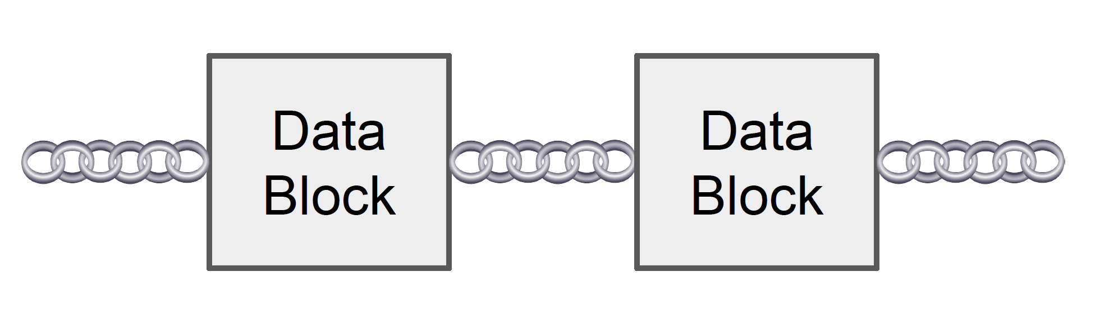
Blockchain
Blockchain is a sequence of data organized in blocks.
◆ Append only.
◆ Readable.
◆ Tamperproof.
Hash pointer

Slide 4
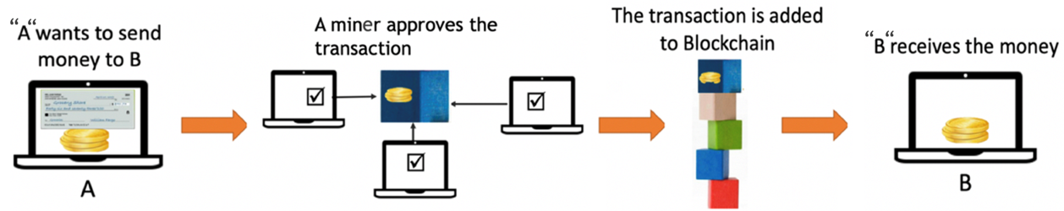
Blockchain
Each block contains:
◆ A cryptographic hash of the previous block.
◆ A timestamp.
◆ Transactions data.

Slide 5
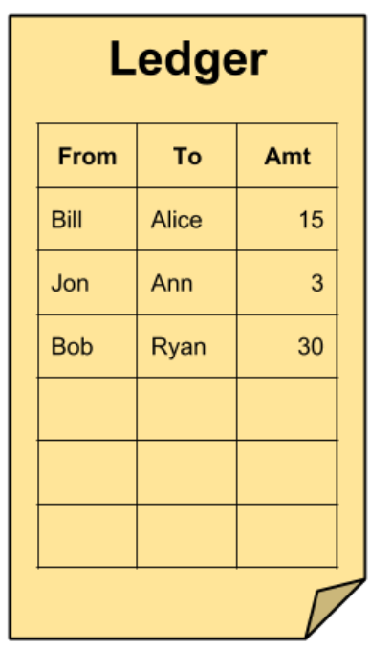
Bitcoin
A software-based online payment system.
A form of digital currency created and held electronically.
Payments are recorded in a public ledger.
Notes:
Change from miners to a miner.

Slide 6
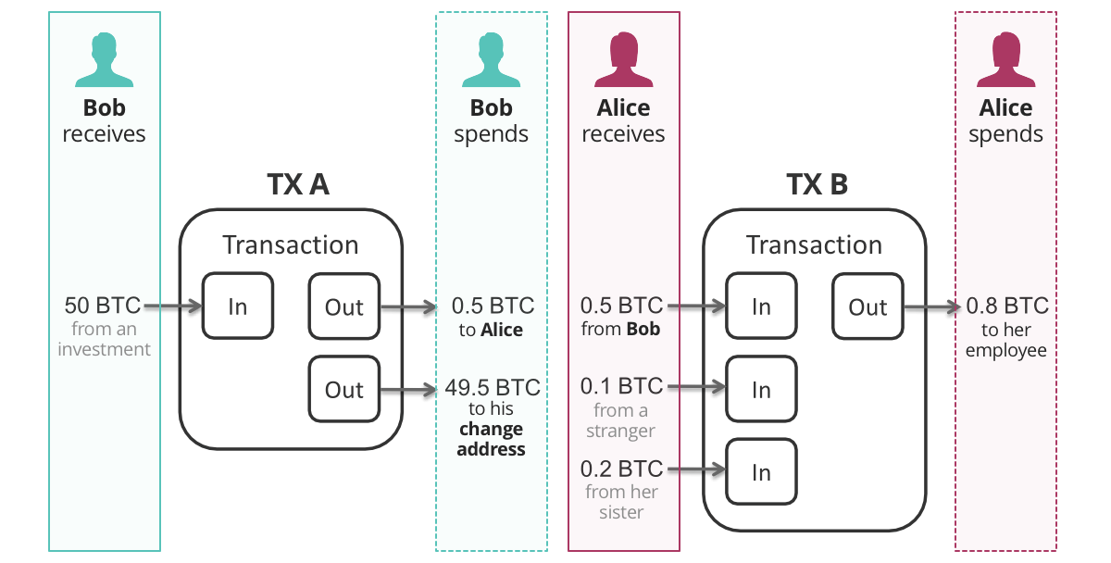
Transaction
A transaction consists:
◆ A transaction id.
◆ One or more inputs and outputs.
Each transaction has a unique id, therefore can be used only once.

Slide 7

The Main Problem
Waiting more than ten minutes just to get a coffee is not practical.
Why do we need to wait ?

Slide 8
Delayed Confirmation Time
Our transaction gets into a new block.
The block needs to wait before getting in to the blockchain.
◆ The process is called mining.

Slide 9

Mining
The process of solving a mathematic problem.
◆ Solving is done by miners.
◆ The miners will get fees for their work.
A new block is added to the blockchain after a puzzle was solved.
◆ Ten minutes is the average time for a block.

Slide 10

Another Problem
So let’s try sending a transaction without waiting.
A new problem: Double Spending.

Slide 11
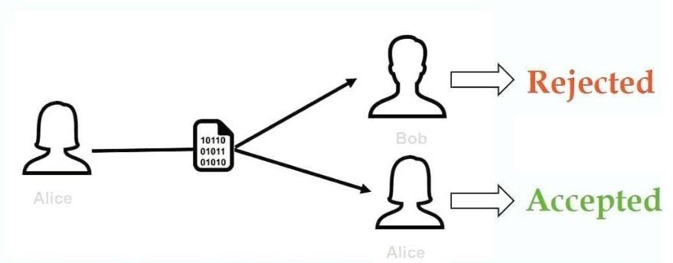
Double Spending
Alice has money for one transaction.
1. Alice creates two transactions:
◆ A transaction to Bob.
◆ A transaction to herself.
2. Bob delivers the goods to Alice.
3. The transaction between Alice and Bob is canceled.
4. Bob doesn’t get paid.

Slide 12
Outline
Introduction
Goals
The solution
Implementation
Conclusion

Slide 13
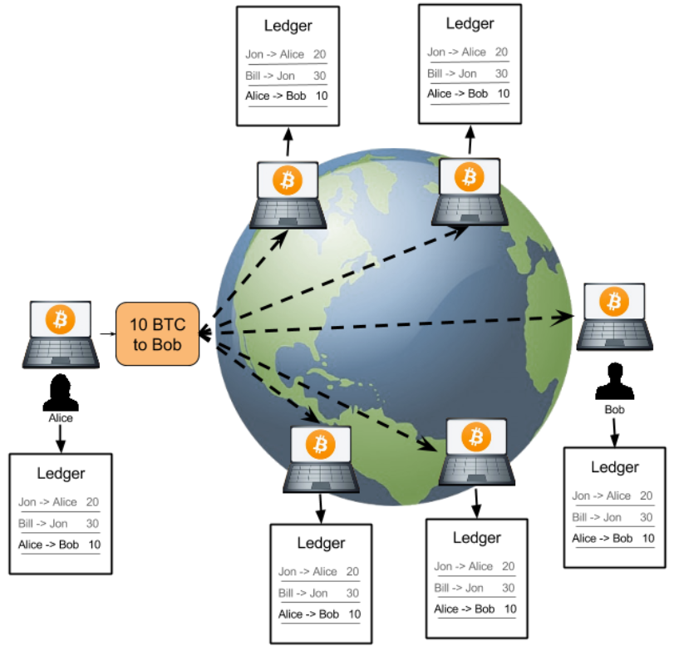
Goals
Understand the concepts behind blockchain.
Simulate a cryptocurrency system using python.
The simulation will include:
An empty blockchain.
Participants.
Simulation of transactions between participants.

Slide 14
Outline
Introduction
Goals
The solution
Implementation
Conclusion

Slide 15



The Solution
A mechanism for Bitcoin zero-confirmation of transactions.
◆ Using the Bitcoin’s scripting language.
By using the properties of the inputs, we will address the problem.
Mediator

Slide 16
Mechanism Explanation
We initiated an empty environment with no prior transactions.
Three participants:
◆ A buyer – “A”.
◆ A seller – “B”.
◆ A mediator – “M”.

Slide 17
Creating A Participant
Each participant has:
◆ An address.
◆ A private key.
◆ A public key.

Slide 18



Address
A Bitcoin address is an identifier of 26 to 35 alphanumeric characters.
An address can be generated by any user.
There are three types of addresses:
◆ The types begin with “1”, ”3” and “bc1”.
◆ Each type has a specific use.

Slide 19
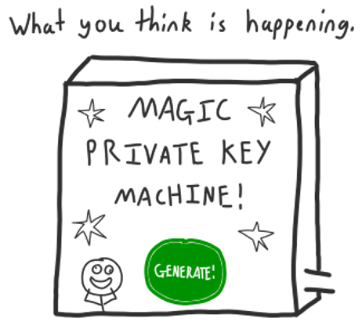

Private Key
It is a secret number that allows Bitcoins to be spent.
Private keys are mathematically related to all Bitcoin addresses generated.

Slide 20
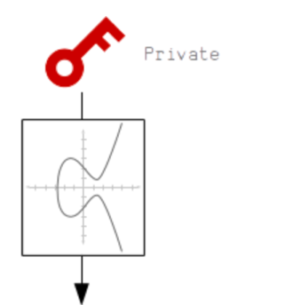
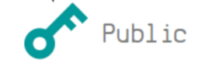
Public Key
A public key is a cryptographic code.
The key allows a user to receive Bitcoins.
The public key coupled with the private key, ensures the protection of the crypto economy.

Slide 21
Mechanism Explanation
We transferred Bitcoins to “A” using the system functions.
Created a joint address between “A” and “M”.
◆ The joint address is called “A+M”.
The creation process:
Appending “A”,“M”’s public keys to an array.
Adding the address to the system.
Using the system functions, creating a multisig address.

Slide 22
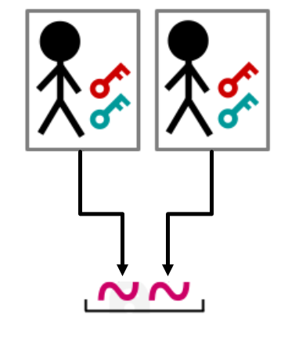
Multisig
Multisig refers to requiring more than one key to authorize a transaction.
For a transaction to occur, it requires multiple signatures, possibly by different private keys.

Slide 23
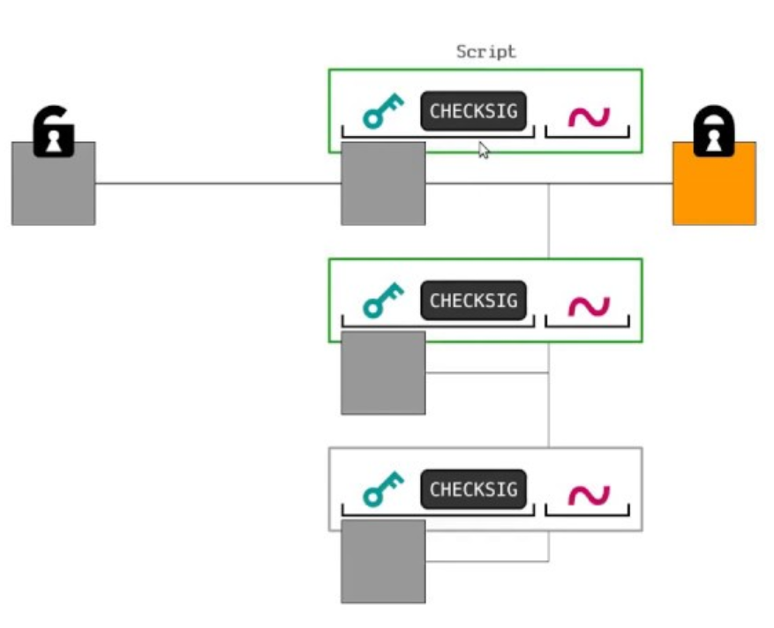
Mechanism Explanation
We transfer Bitcoins from “A” to the multisig address.
◆ The money transferred would be called the deposited money.
Now, we would like to transfer the due money of the purchase.
We will be using scripts to implement the transfer.

Slide 24
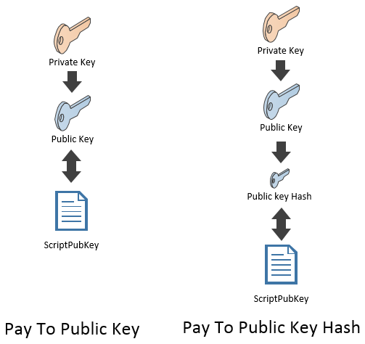
Pay To Public Key Hash (P2PKH)
A type of an output created with a public key.
To commit a transaction:
◆ Need to provide a digital signature – a private key.
◆ The private key should match the public key, used in the output creation.

Slide 25
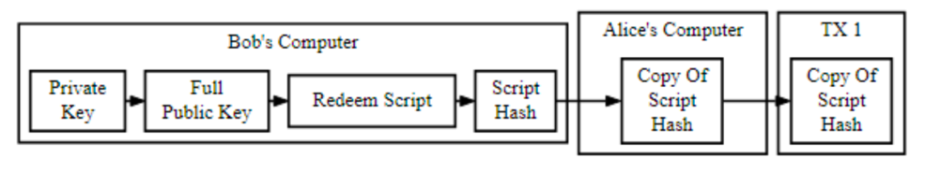
Pay To Script Hash (P2SH)
The script allows to lock Bitcoins to a hash.
In order to unlock those Bitcoins you must provide certain requirements of the script.

Slide 26
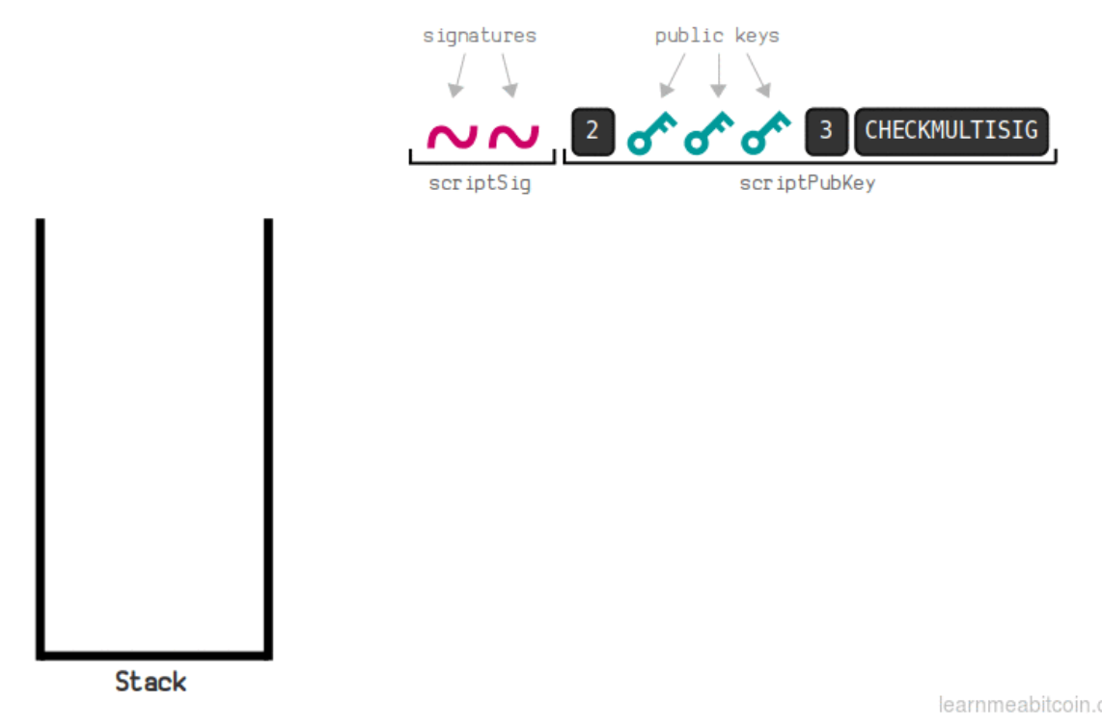
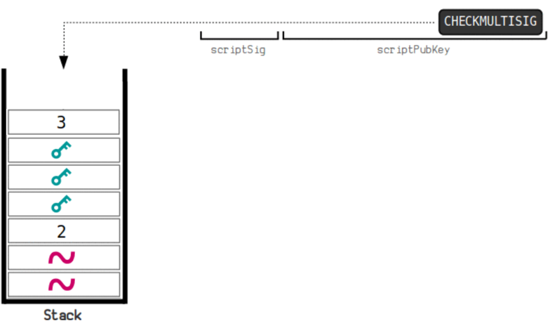
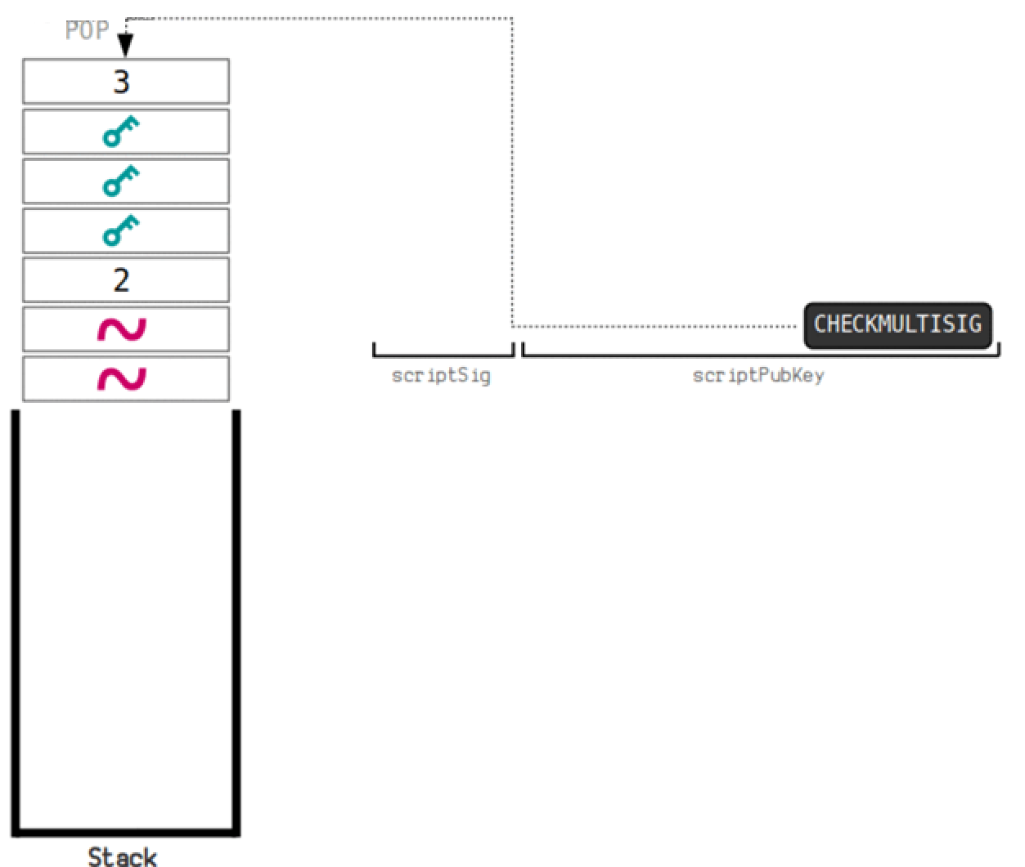
Script Run
1. Receiving all the necessary inputs.
2. Pushing the inputs in to the stack.
3. Check the validity in reverse order.

Slide 27



Mechanism Explanation
The possible scenarios:
◆The Good scenario. ◆The Bad scenario.
We defined time-limit which separates between the two scenarios.
If the due money was transferred before time-limit – the good case.
Else - the bad case.

Slide 28
First Scenario – Good Case
The deposit transaction, back in history
A
A+M
MULTISIG
A+M cannot pay
A->B
Inputs:
Txid 2
Outputs:
◆ 25 -> B
◆ 24.95 -> A
◆ 0.05 -> fee
Txid 1
Txid 2
Txid 2
B
The good purchase
time

Slide 29
First Scenario – Good Case
The transaction between “A” and “B” happened and succeeded in time.
The transaction between “A+M” and “B” cannot happen, due to a one time input use.

Slide 30
Second Scenario – Bad Case
The deposit transaction, back in history
A
A+M
MULTISIG
A->B
Inputs:
Txid 2
Outputs:
◆ 25 -> B
◆ 24.95 -> A
◆ 0.05 -> fee
Txid 1
A+M pay
Txid 2
Txid 2
B
“A” can not transfer money
time

Slide 31
Second Scenario – Bad Case
The transaction between “A” and “B” was out of time.
The transaction between “A+M” and “B” succeeded.
The transaction between “A” and “B” cannot happen, due to one-time input use.

Slide 32
Outline
Introduction
Goals
The solution
Implementation
Conclusion

Slide 33
Implementation
Our system uses python scripting and JSON-RPC, in order to connect the Bitcoin’s client.
We used different libraries functions of the Bitcoin core.
We setup our system on the reg-test environment.
We used Github to sync our project with Itay.
◆ https://github.com/BarakGahtan/bitcoin_project_s19

Slide 34
Key Functions
Abstract Implementation:
Private Key Generator
Transaction Single To
Bitcoin Core client
RPC
Transaction Single To Single
Transaction Multi To Single

Slide 35
Key Functions
Private Key Generator:
◆ Creates a private key using a random function.
◆ Public key is derived from the private key.
◆ Address is derived from the public key.
Public key
Random function
Private key
Address

Slide 36
Key Functions
Transaction Single To:
◆ Transfers Bitcoins from a generated block to another address.
◆ Parameters: a source, destinations, a private key, a block id and an amount of money.
Source
Destination
Private key
CreateRawTransaction
SignRawTransaction
SendRawTransaction
Block id
Amount

Slide 37
Key Functions
Transaction Single To Single:
◆ Transfers Bitcoins from a single participant address to another address.
◆ Parameters: a source, destinations, a private key, a TXID number, a redeem script and an amount of money.
Source
Destination
CreateRawTransaction
DecodeRawTransaction
Private key
TXID
SignRawTransaction
SendRawTransaction
Redeem script
Amount

Slide 38
Key Functions
Transaction Multi To Single:
◆ Transfers Bitcoins from a multisig address to another address.
◆ Parameters: a source, destinations, a private key, a TXID number, a redeem script and an amount of money.
Source
Destination
CreateRawTransaction
DecodeRawTransaction
Private key
TXID
SignRawTransaction
SendRawTransaction
Redeem script
Amount

Slide 39
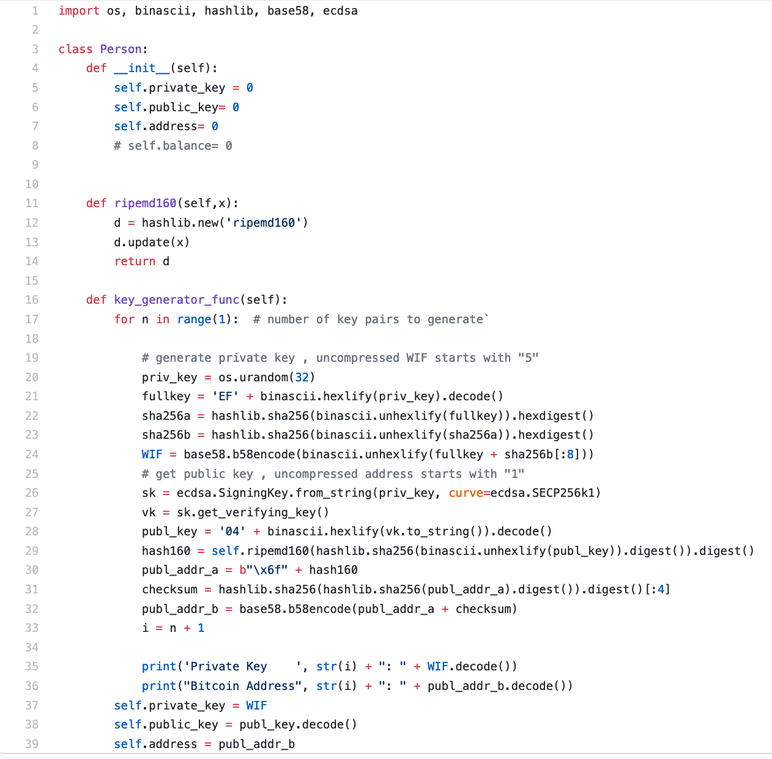
Functions
Private Key Generator:

Slide 40
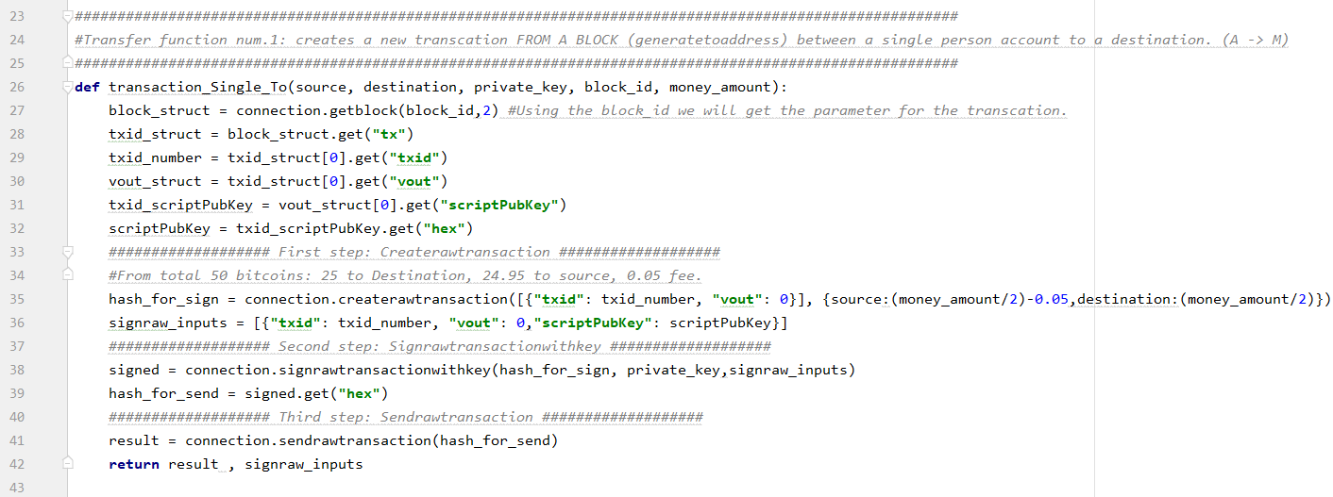
Functions
Transaction Single To:

Slide 41
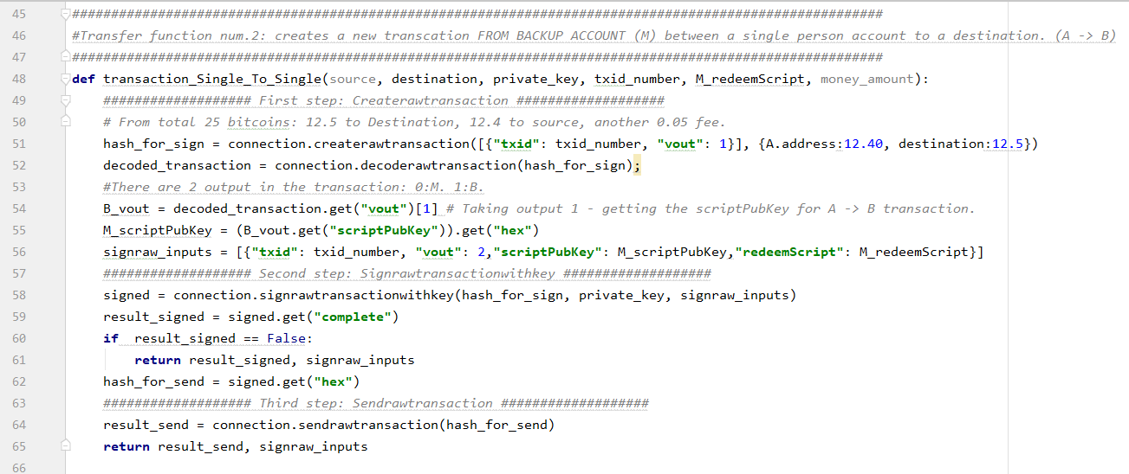
Functions
Transaction Single To Single:

Slide 42
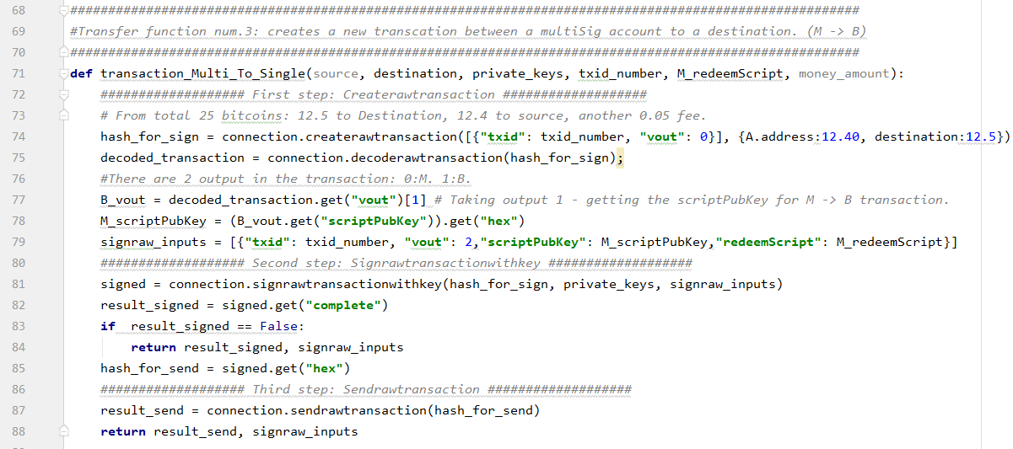
Functions
Transaction Multi To Single:

Slide 43
Outline
Introduction
Goals
The solution
Implementation
Conclusion

Slide 44
Conclusion
The use of RPC to communicate with Bitcoin core eased the work with the core’s functions.
Reg-test mode helped us to understand the flow of transactions.
Using our simulated environment we tried several schemes until a specific one worked.
Reading the theoretic materials regarding blockchain and Bitcoin assisted us in the implementation part.

Slide 45
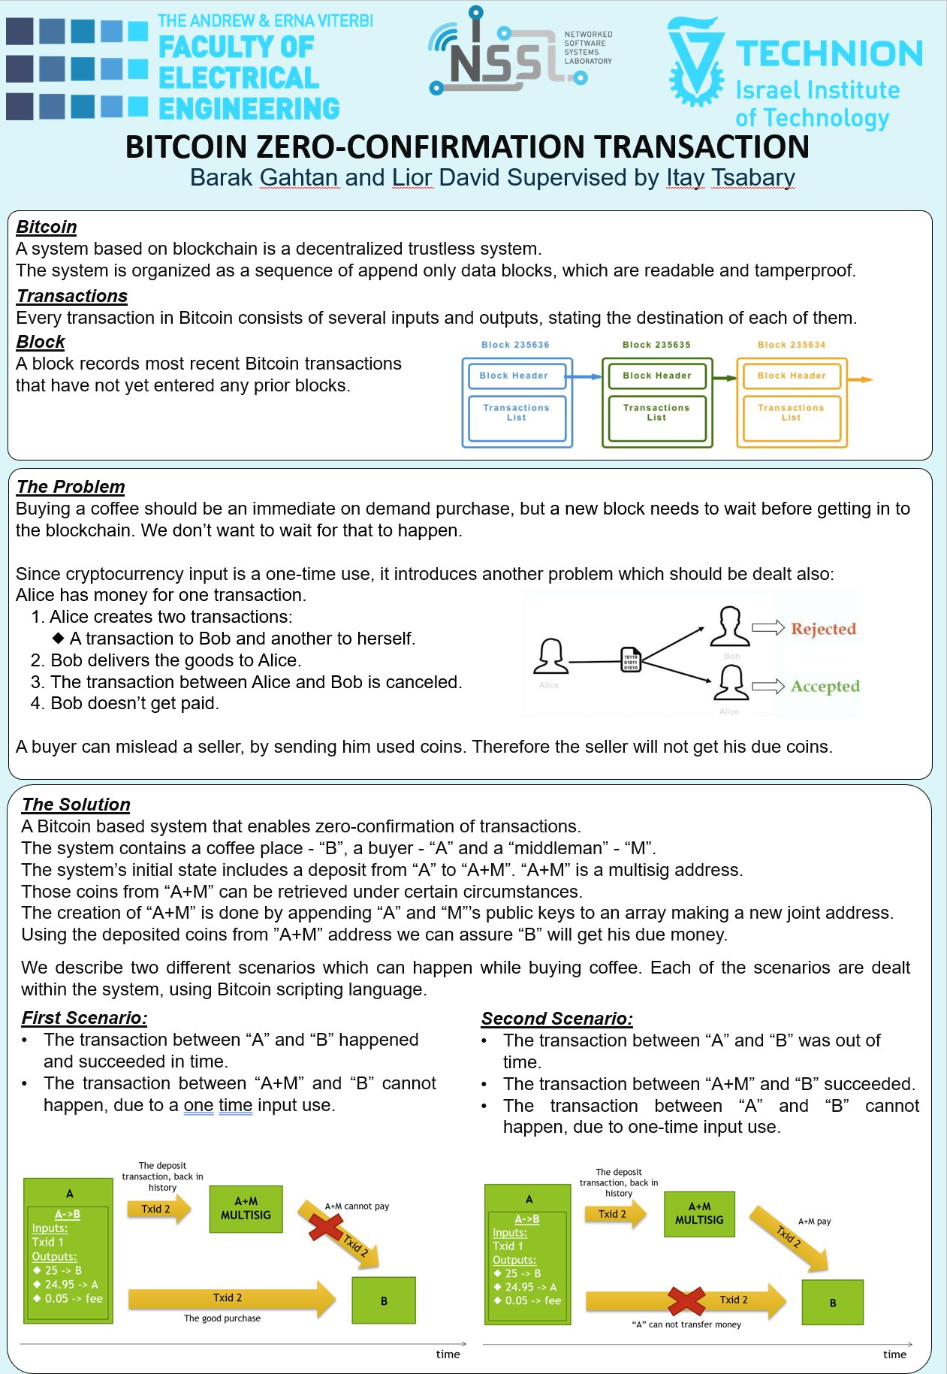
Poster

Slide 46

Questions?

